Slide 1
Lab 6
LCD

Slide 2
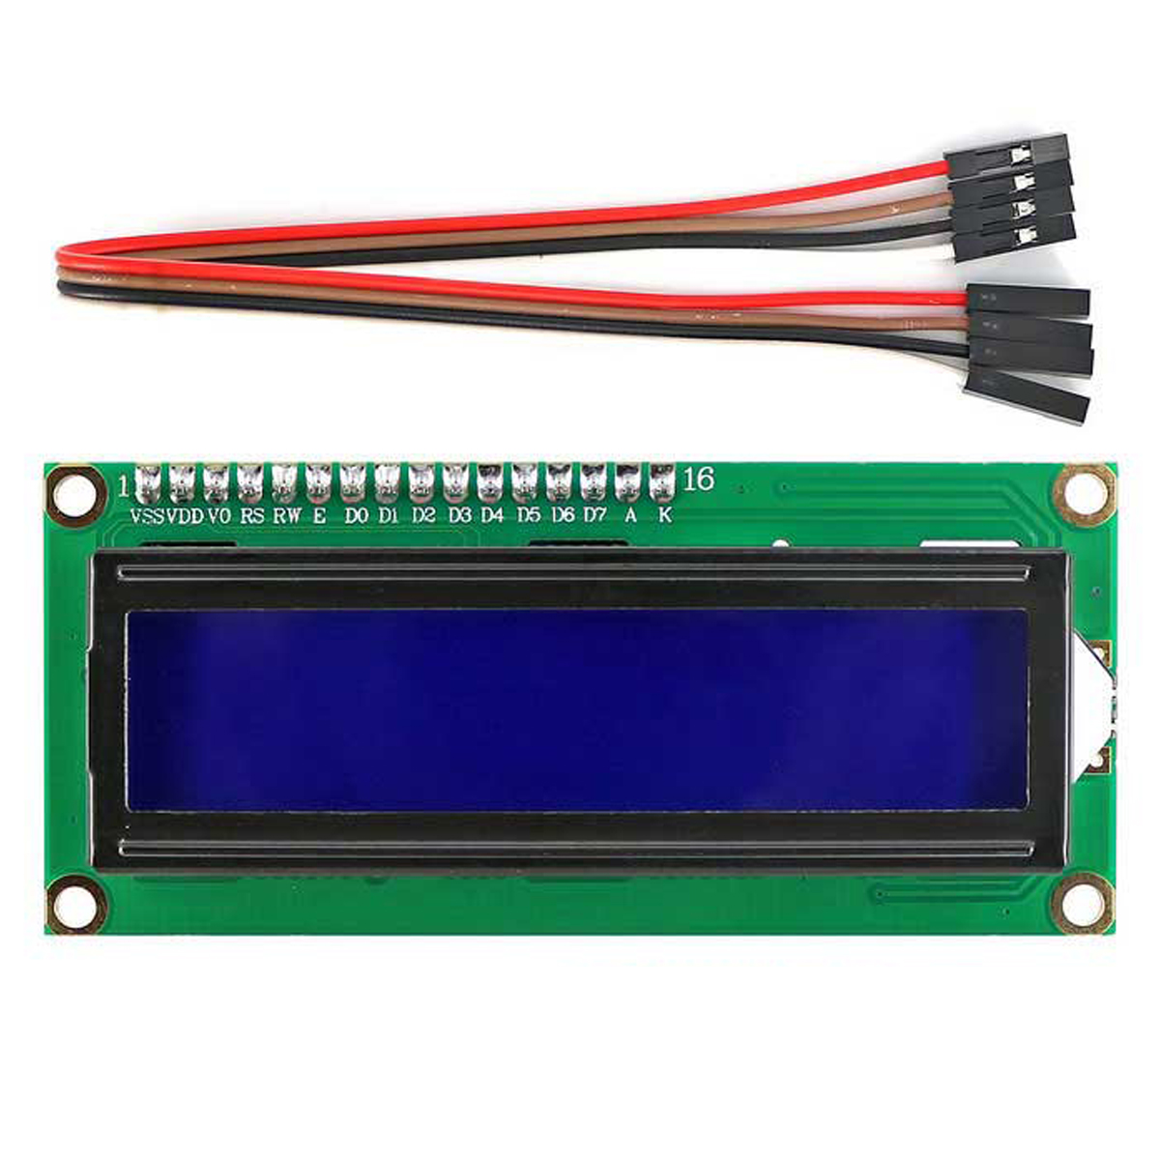
What is LCD?
LCD 16x2 is a 16-pin device that has 2 rows that can accommodate 16 characters each.
LCD 16x2 can be used in 4-bit mode or 8-bit mode.
It is also possible to create custom characters. It has 8 data lines and 3 control lines that can be used for control purposes.

Slide 3
Soldering LCD
Welding/Soldering Pins to an LCD - For Beginners - Arduino, Raspberry Pi learning - YouTube

Slide 4
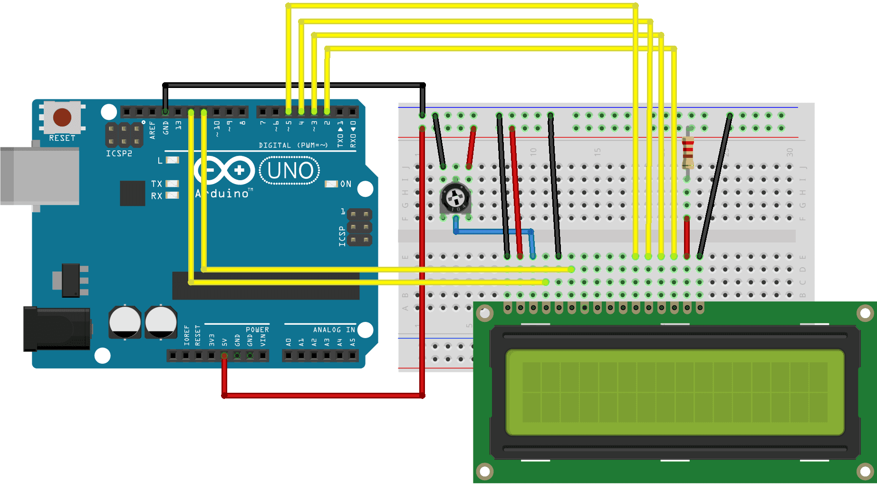
Circuit - Connection to Arduino

Slide 5
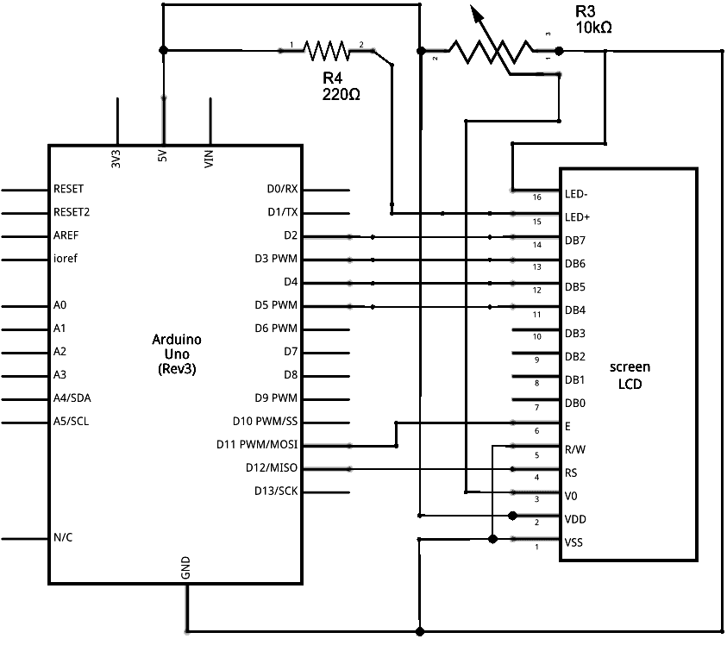
Activity-1
Draw the schematics for the previous circuit.

Slide 6
Activity-2
Print “Hello world” on the LCD.

Slide 7
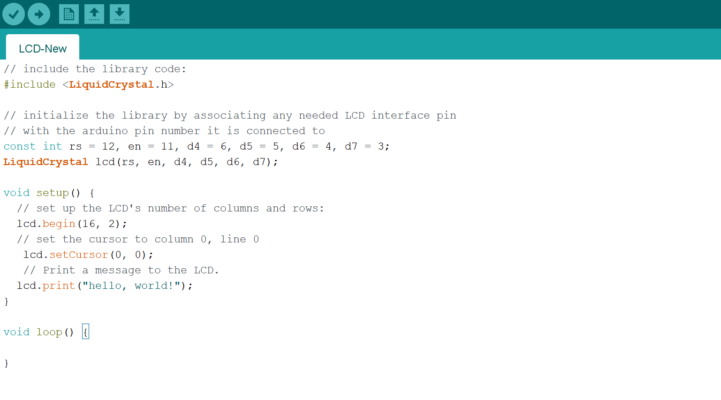
Code

Slide 8
Activity-3
Open the Serial Monitor and type some characters and click Send. The text will appear on your LCD.

Slide 9
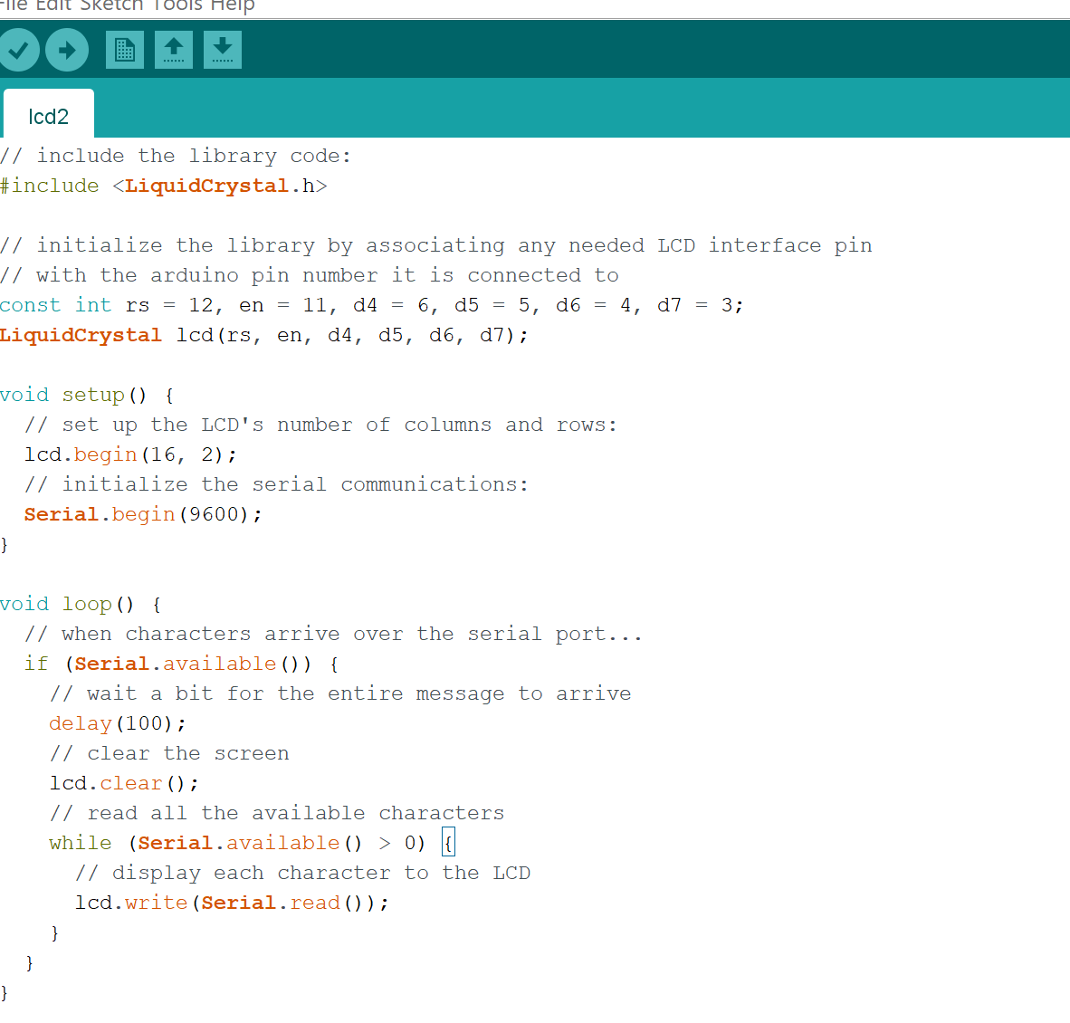
Code

Slide 10
Activity-4
Print the temperature value on the LCD.

